Slide 1
Computer Graphics (L07) EG678EX
2-D Algorithms

Slide 2
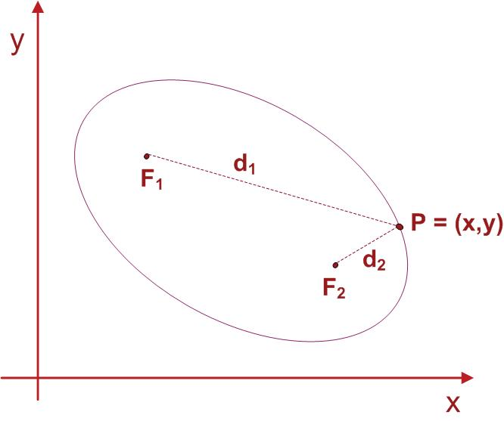
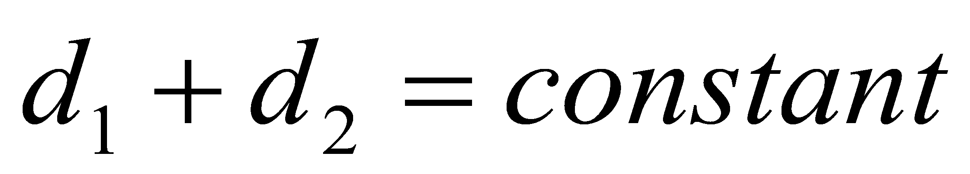
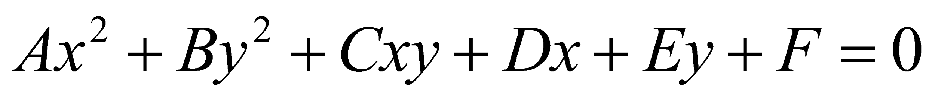
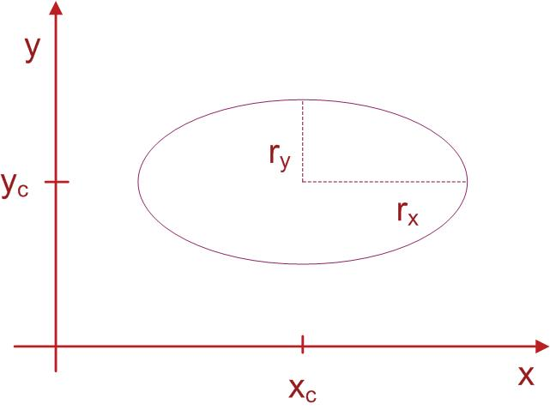
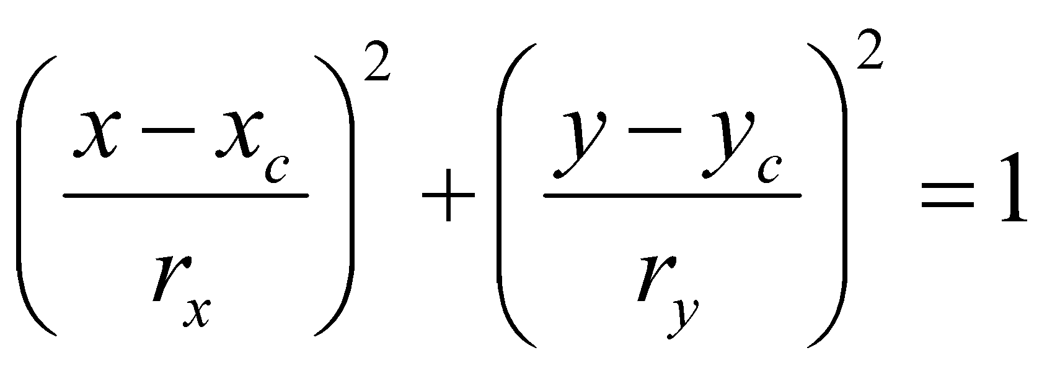
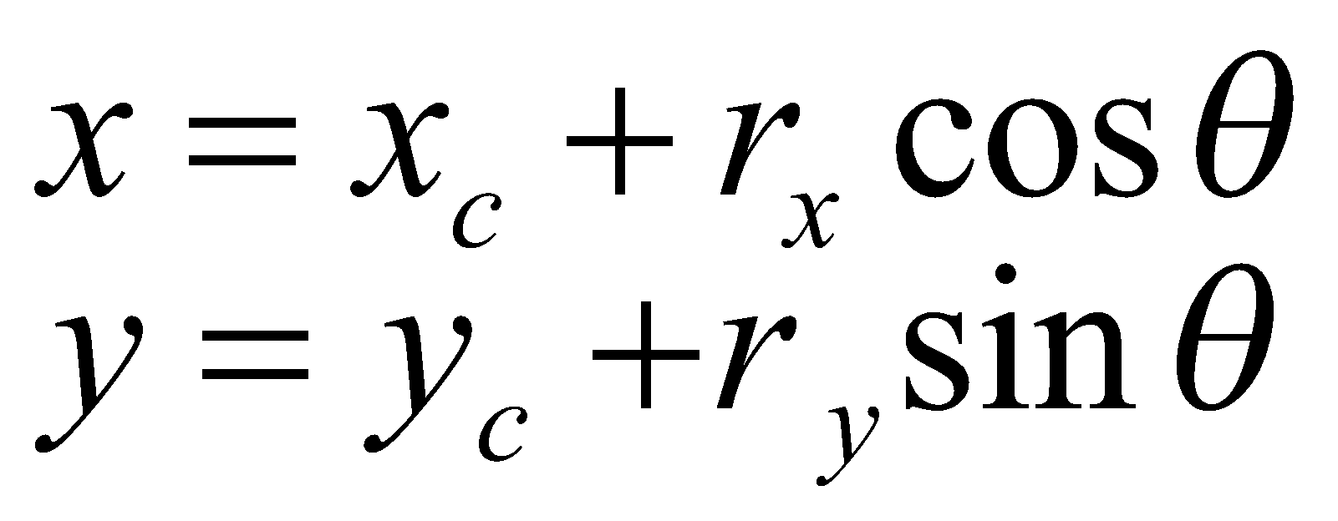
Ellipse Generating Algorithms
Equation of ellipse:
F1🡪(x₁,y₁), F2🡪(x₂,y₂)
General Equation
Simplified Form
In polar co-ordinate

Slide 3
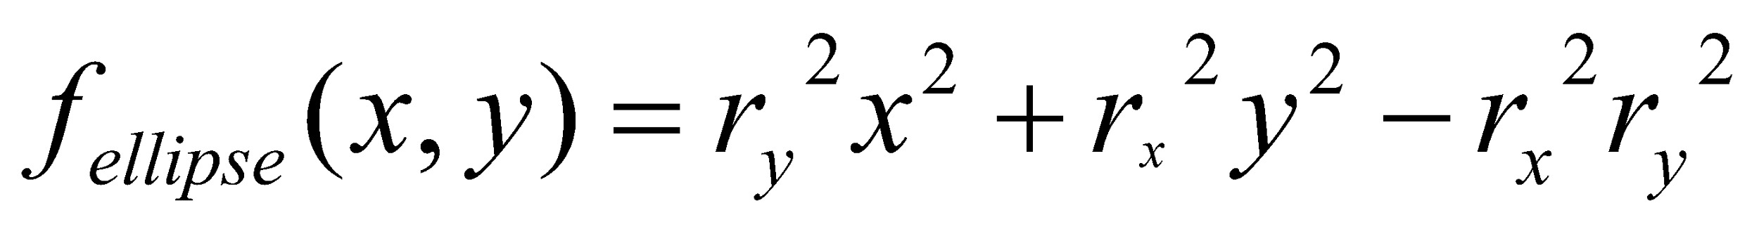
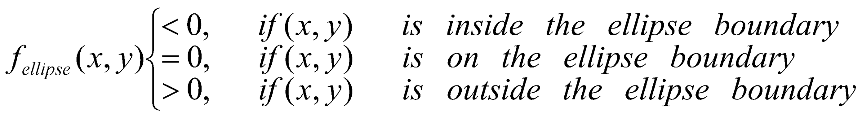
Ellipse function

Slide 4
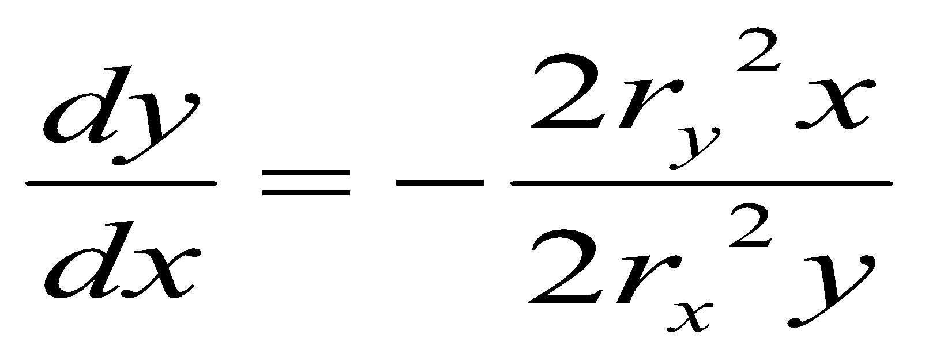
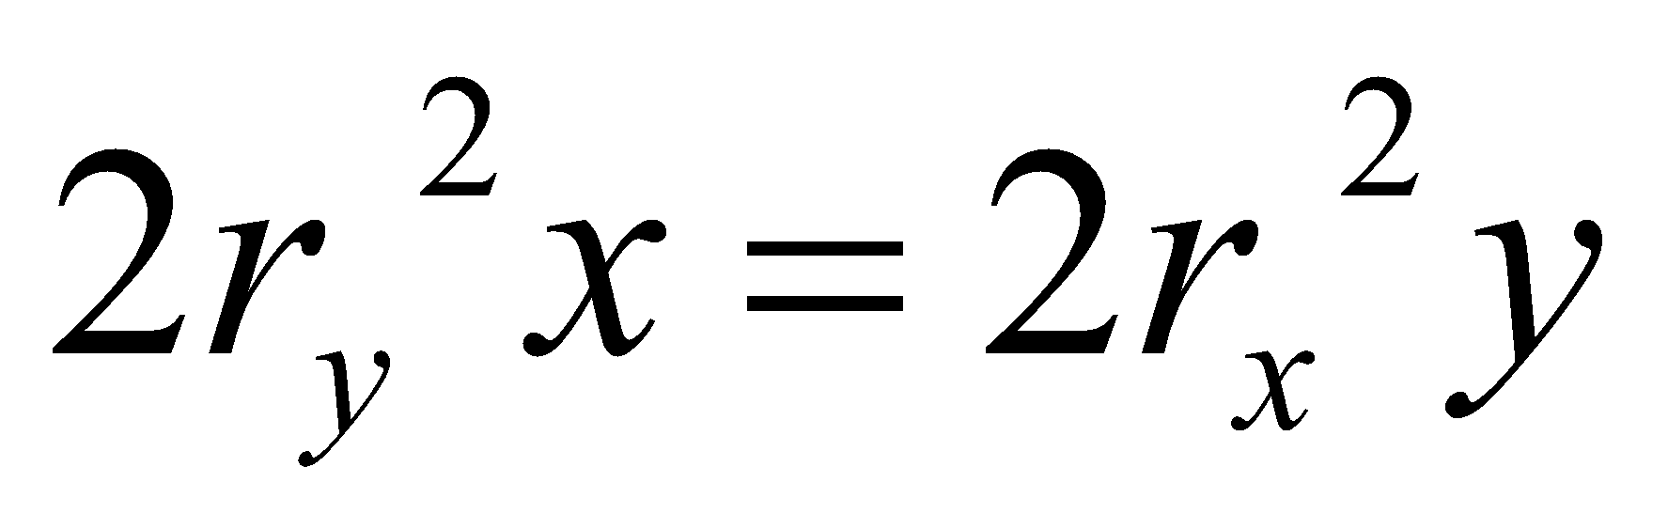
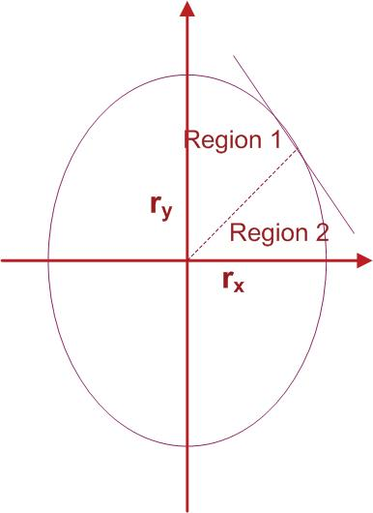
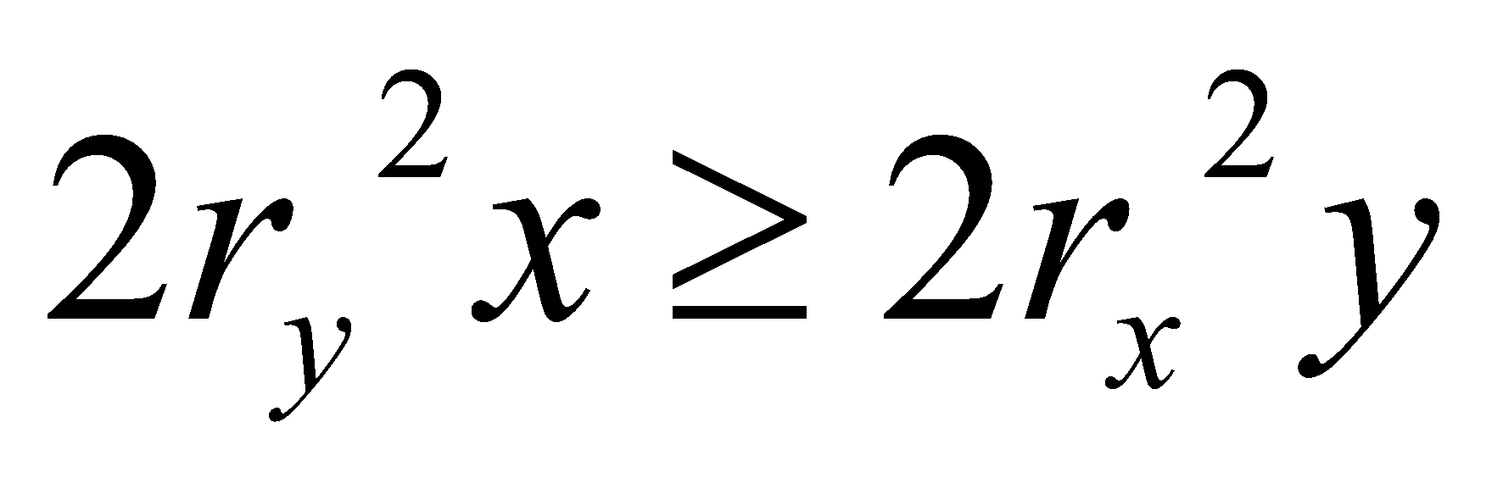
Slope=-1
From ellipse tangent slope:
At boundary region (slope = -1):
Start from (0,r_{y}), take x samples to boundary between 1 and 2
Switch to sample y from boundary between 1 and 2
(i.e whenever )
Slope=-1

Slide 5
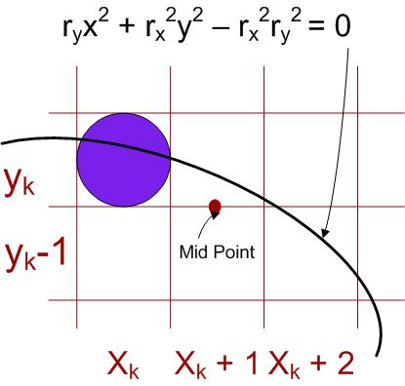
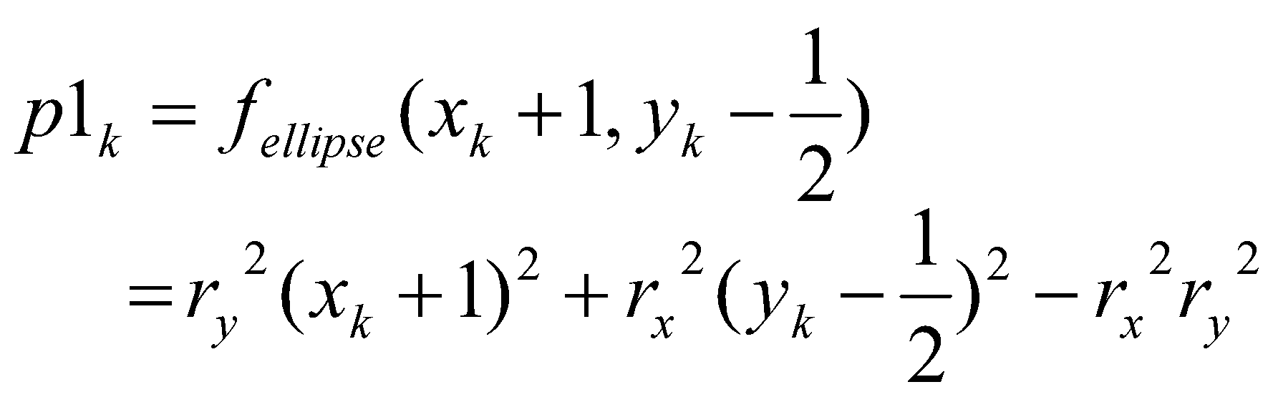
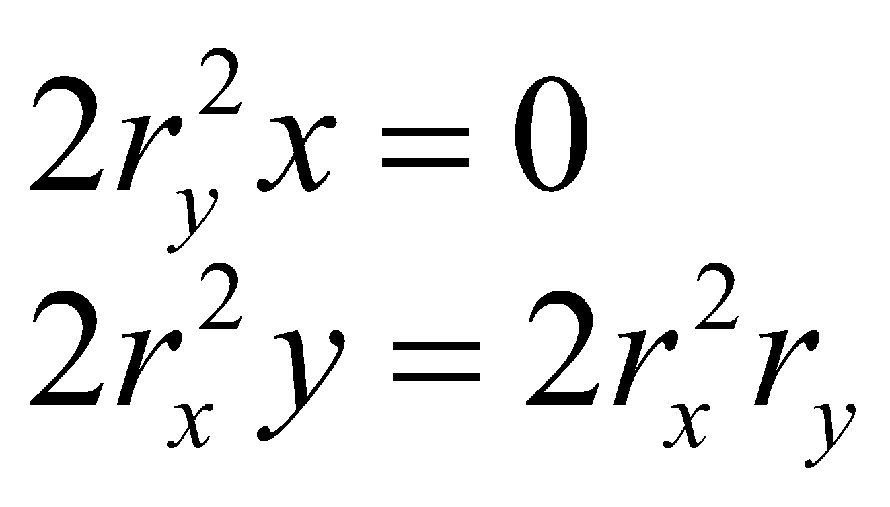
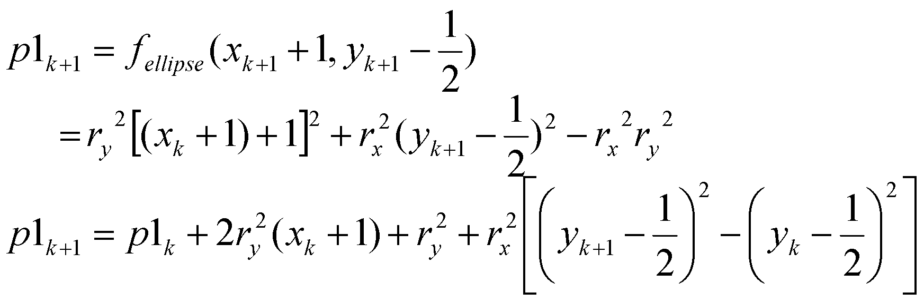
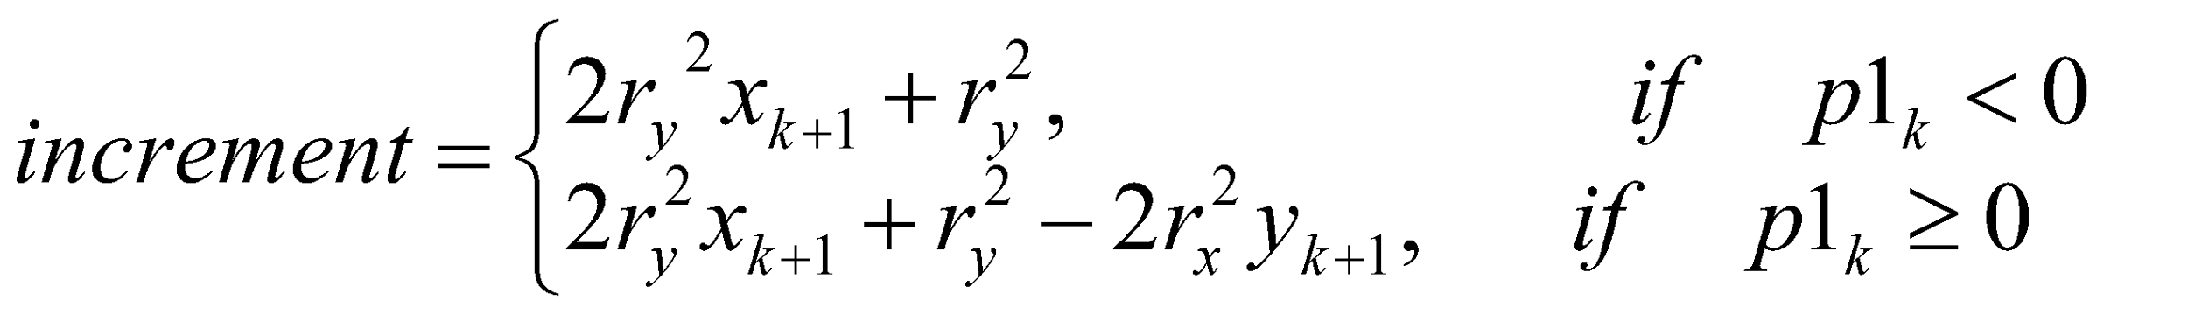
For increment calculation; Initially:
Incrementally:
Update x by adding 2r_{y}² to first equation and update y by subtracting 2r_{x}² to second equation
In the region 1
For next sample
Thus increment
For increment calculation; Initially:
Incrementally:
Update x by adding 2r_{y}² to first equation and update y by subtracting 2r_{x}² to second equation

Slide 6
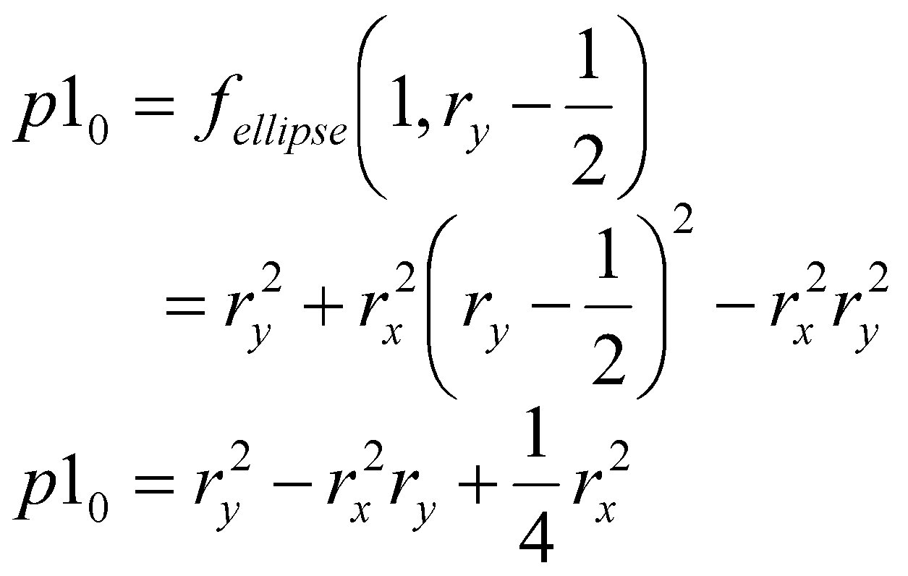
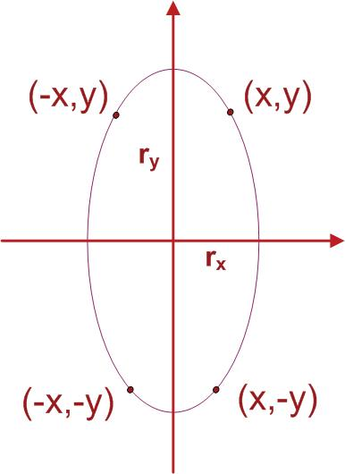
(0,r_{y})
Initial value
(0,r_{y})

Slide 7
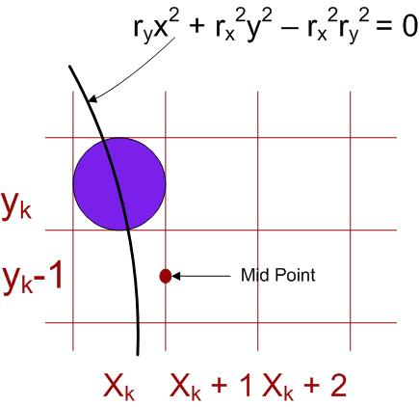
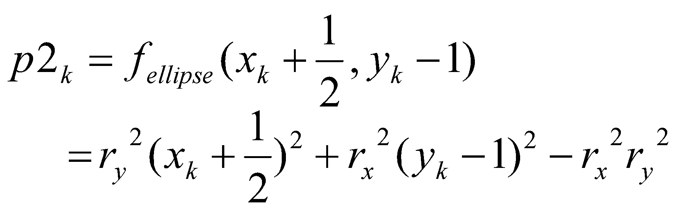
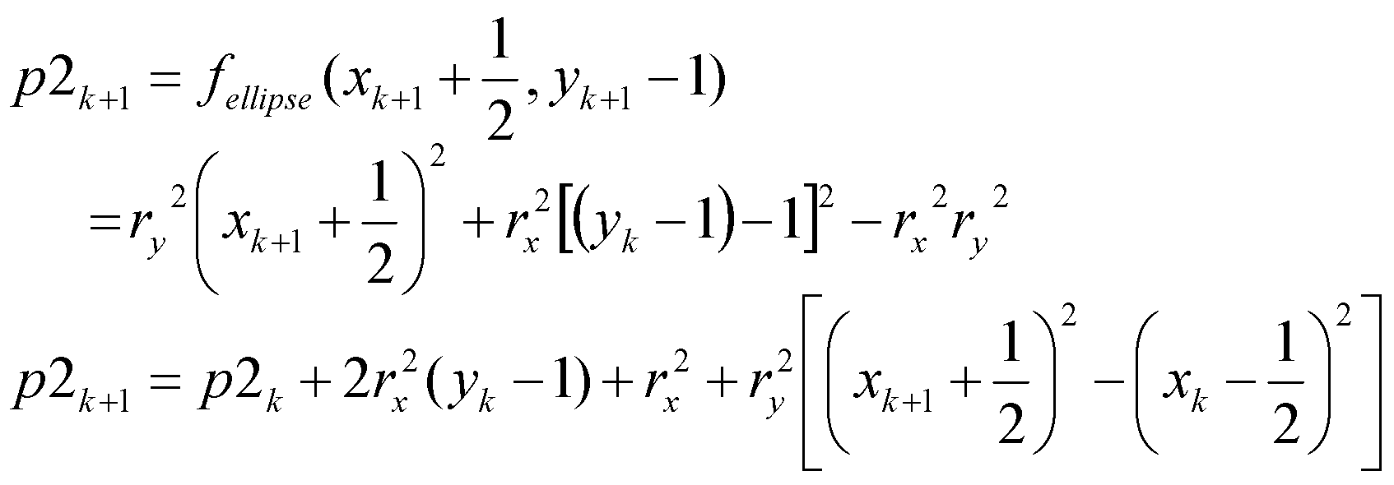
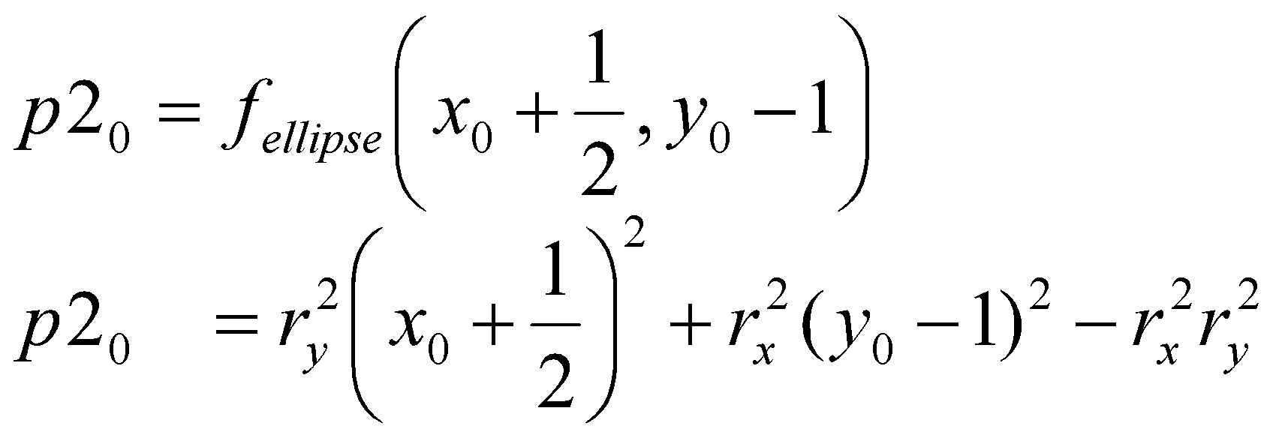
For simplification calculation of p2₀ can be done by selecting pixel positions in counter clockwise order starting at (r_{x},0) and unit samples to positive y direction until the boundary between two regions
In the region 2
For next sample
Initially
For simplification calculation of p2₀ can be done by selecting pixel positions in counter clockwise order starting at (r_{x},0) and unit samples to positive y direction until the boundary between two regions

Slide 8
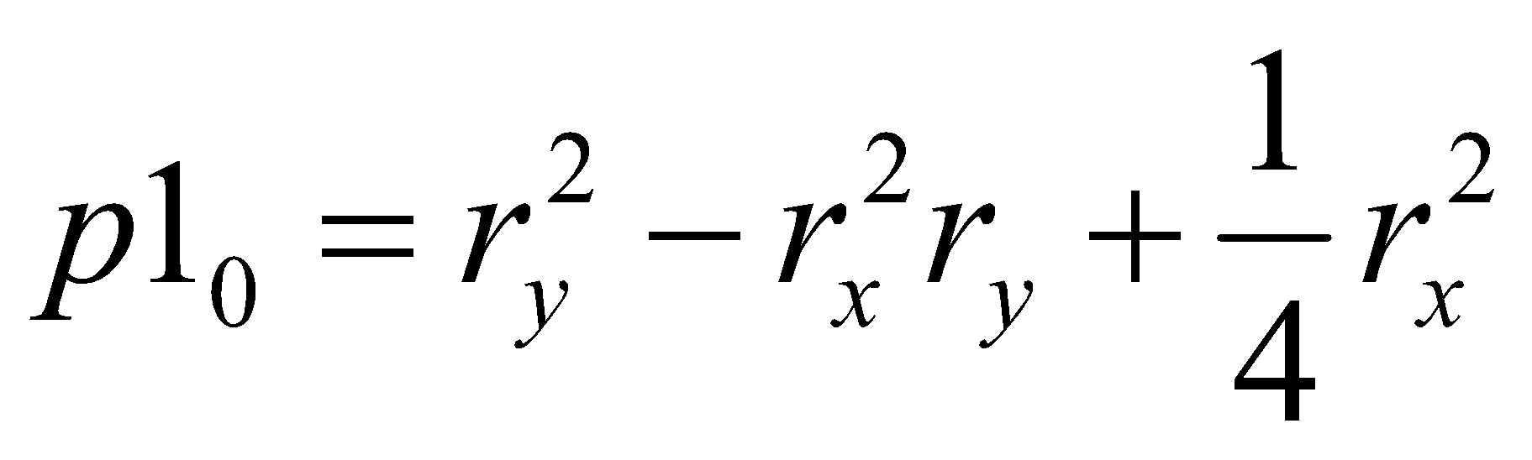
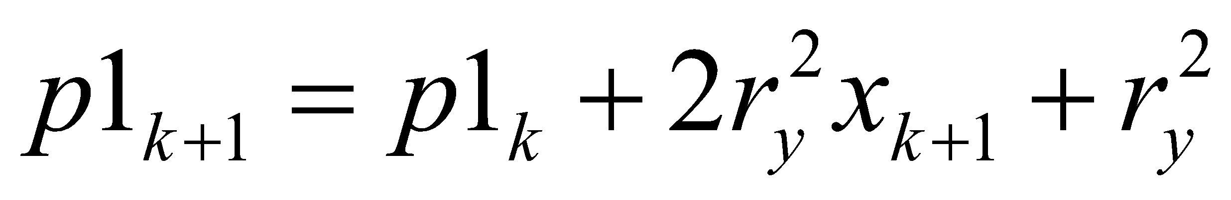
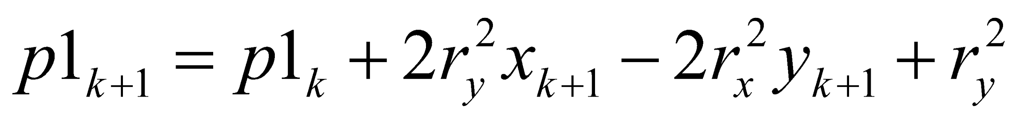
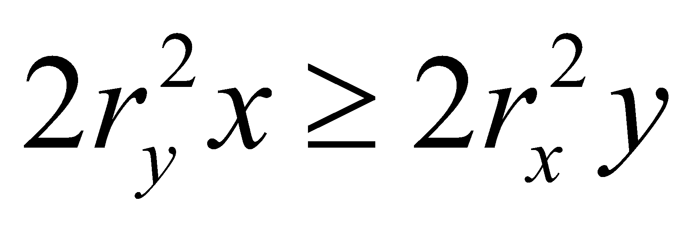
Algorithm
Input r_{x},r_{y}, and the ellipse center(x_{c},yc) and obtain the first point on an ellipse centered on the origin as
(x₀,y₀) = (0,r_{y})
Calculate the initial value of the decision parameter in region 1 as
At each x_{k} position in region 1, starting at k = 0, perform the following test: If p1_{k} < 0, the next point along the ellipse centered on (0,0) is (x_{k+1},y_{k}) and
Otherwise, the next point along the ellipse is (x_{k}+1,y_{k}-1) and
With
and continue until

Slide 9
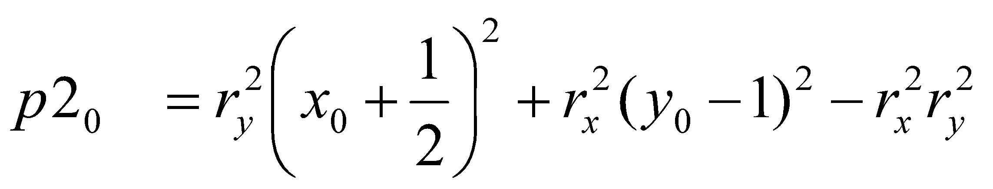
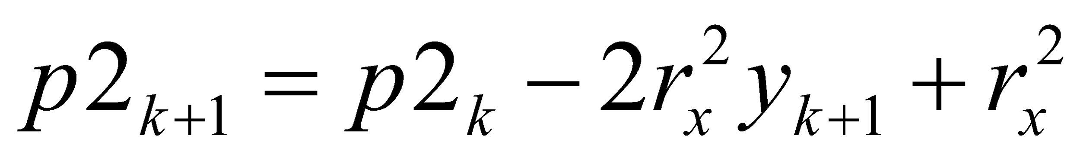
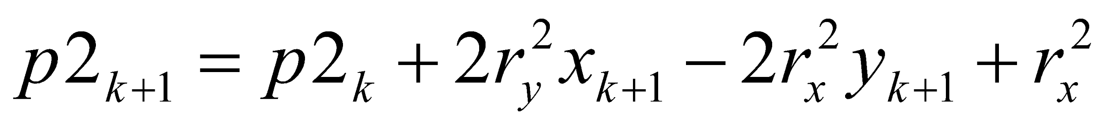
Calculate the initial value of decision parameter in region 2 using the last point (x₀,y₀) calculated in region 1 as
At each y_{k} position in region 2, starting at k = 0, perform the following test: If p2k>0, the next point along the ellipse centered on (0,0) is (x_{k},y_{k}-1) and
Otherwise the next point along the ellipse is (x_{k}+1,y_{k}-1) and
Using the same incremental calculations for x and y as in region 1.
Determine the symmetry points in the other three quadrants.
Move each calculated pixel position (x,y) onto the elliptical path centered on (x_{c},y_{c}) and plot the co-ordinate values:
X = x + x_{c}, y = y+ y_{c}
Repeat the steps for region 1 until

